Slide 1
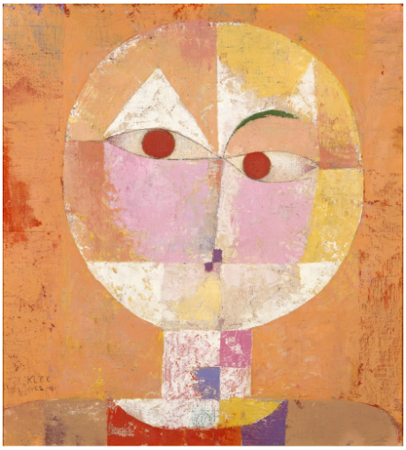
Paul Klee – Abstract & Color
WELCOME TO 1st GRADE ART!

Slide 2
ART RULES
All classroom rules apply.
HAVE FUN!
Raise your hand and ask for help BEFORE you get frustrated.
I don’t want your art to be “perfect” there is no such thing as perfect in art. Just let it be yours.
KEEP IT POSITIVE when talking about your work and other classmate’s work.
Stand back and take a look – 5 feet rule
Sometimes less is more – especially when we work with paint!
HAVE FUN!

Slide 3
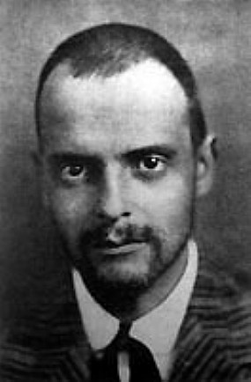
PAUL KLEE
Paul Klee was born in 1879 in Switzerland
His mother was a singer and his father was a music teacher
He started to follow in his parents footsteps and pursue music until he was a teenager and he fell in love with art
He loved a style of art called “cubism”
For 10 years he kept journals and wrote about his art
He made over 9,000 pieces of art in his lifetime

Slide 4
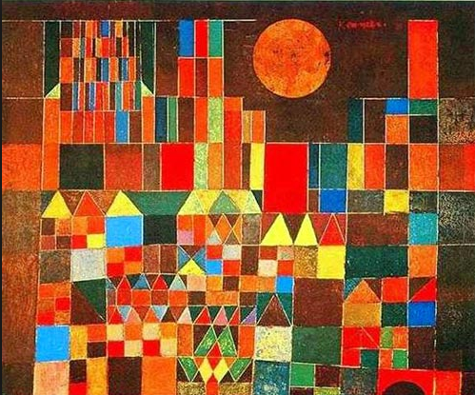
Paul loves how children draw and paint
His paintings have a strong sense of color and rhythm. Paul did not believe he was the best drawer or painter in the world, but he loved creating and took the advice of friends as he saw fit. Klee was fascinated with how children drew and painted. His overall goal was to capture the care free and imaginative drawing style of that of a child.

Slide 6
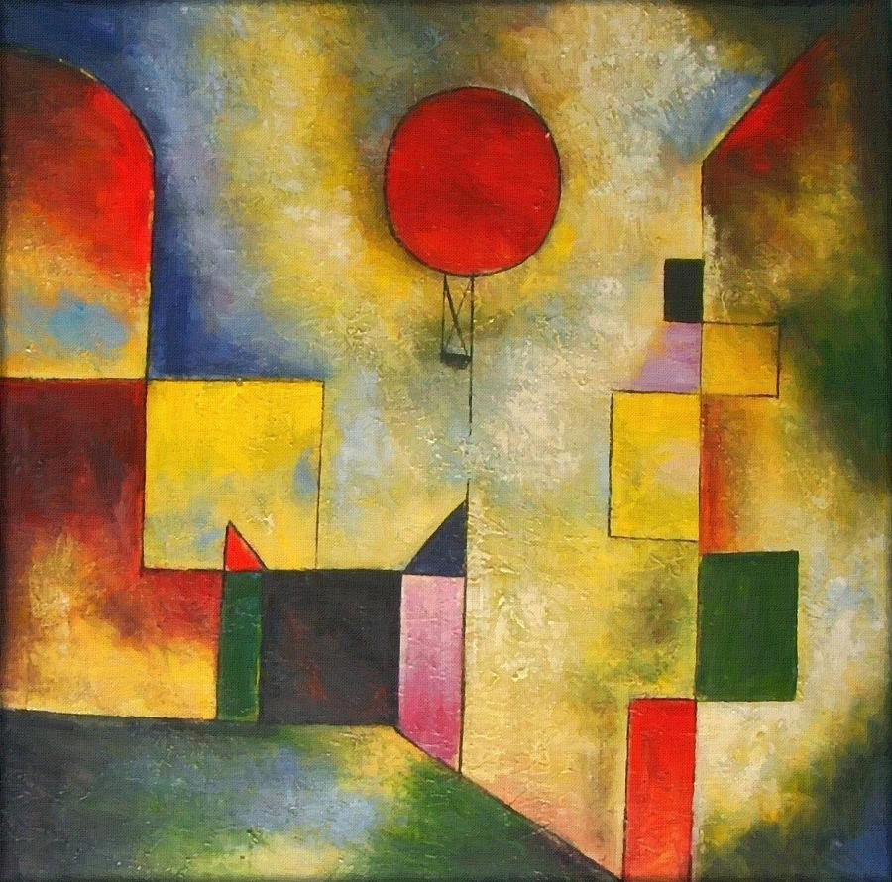
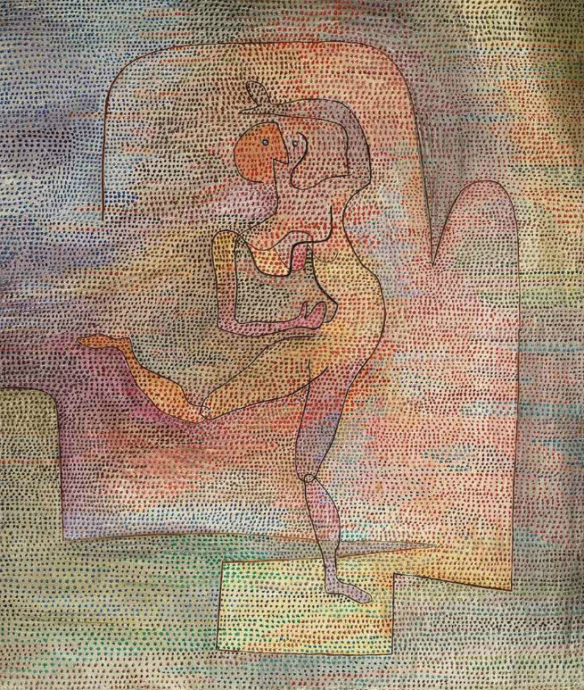
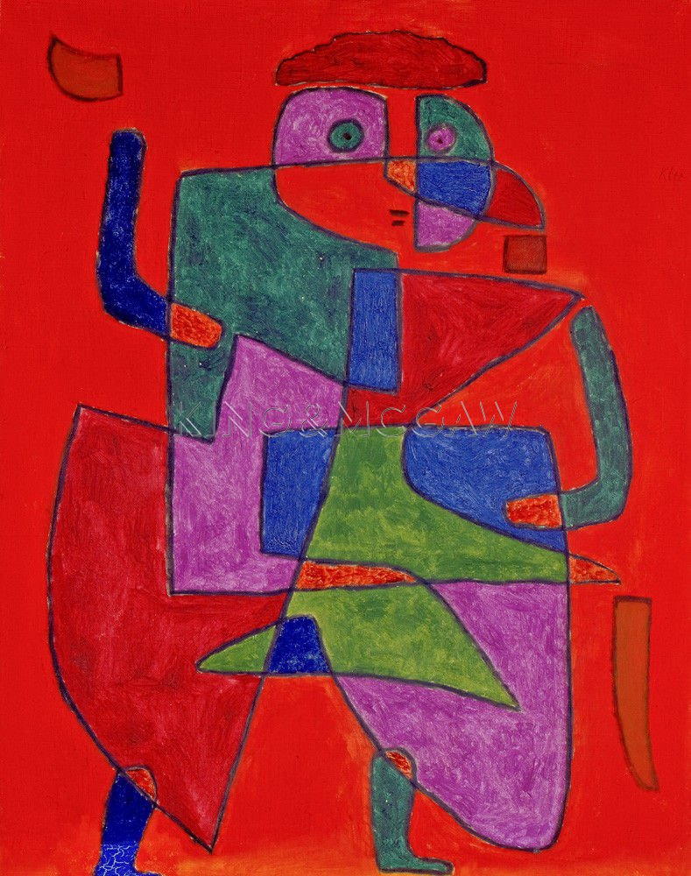
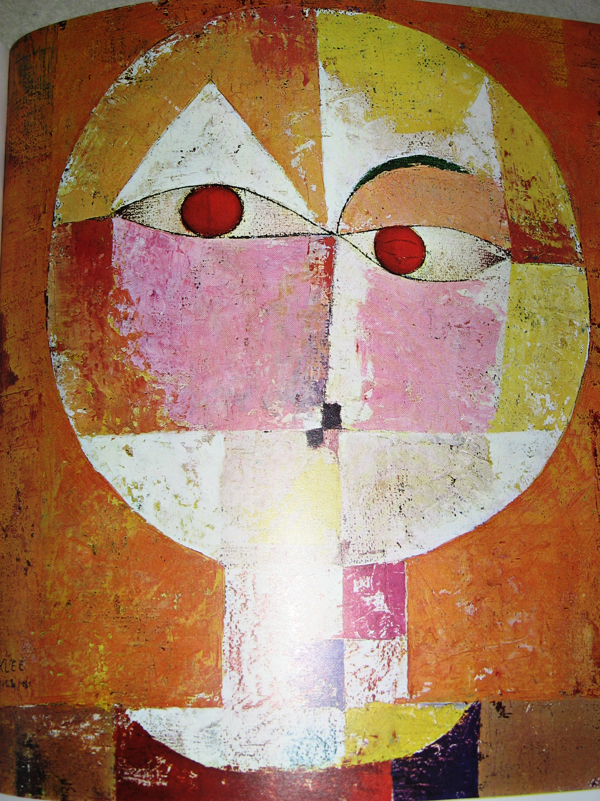
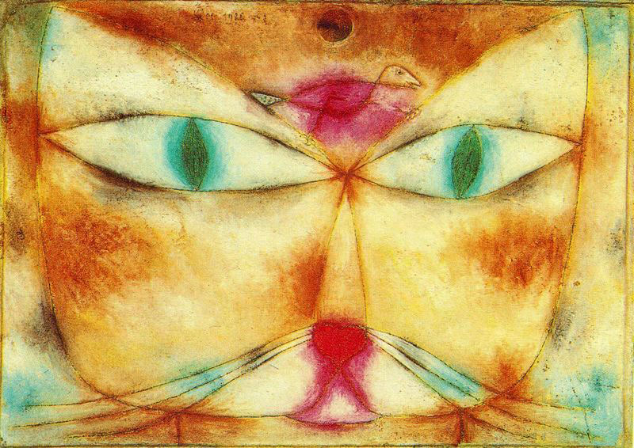
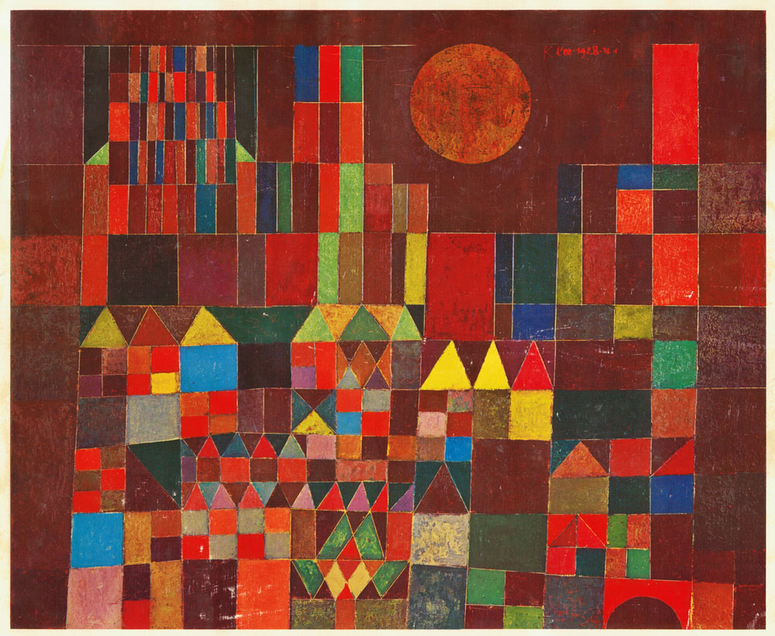
PAUL KLEE’S ART

Slide 7
WHAT WILL WE LEARN TODAY?
The difference between warm and cool colors
Geometric shapes such as circles, triangles or squares have perfect, uniform measurements and don't often appear in nature. Organic shapes (pumpkin) are associated with things from the natural world, like plants and animals.
Overlapping shapes: What is in the foreground? What is in the background? How can we tell?
LETS GO MAKE ART!!!!!

Slide 8
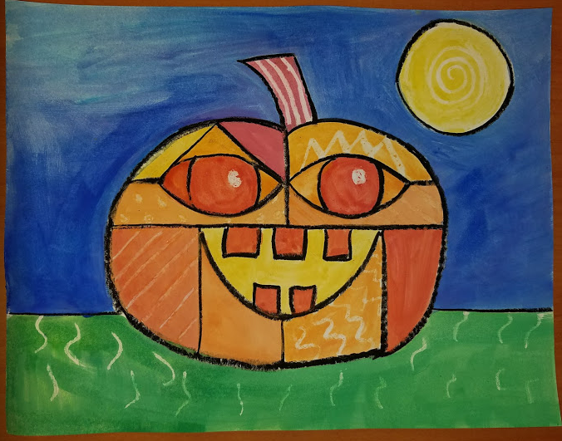
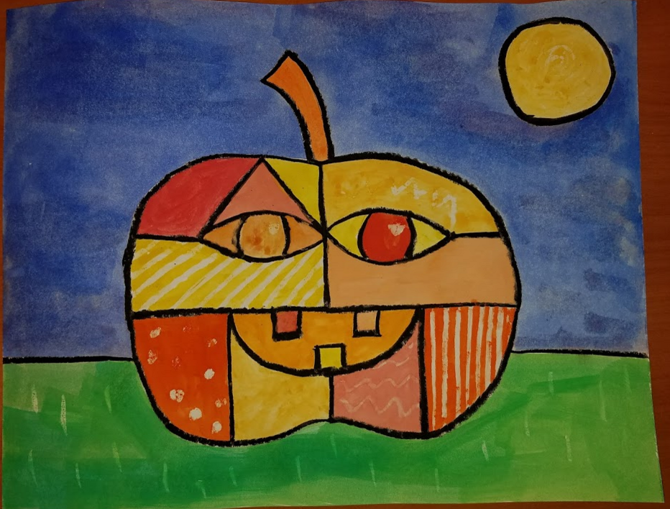
Klee Inspired Pumpkins

Slide 9
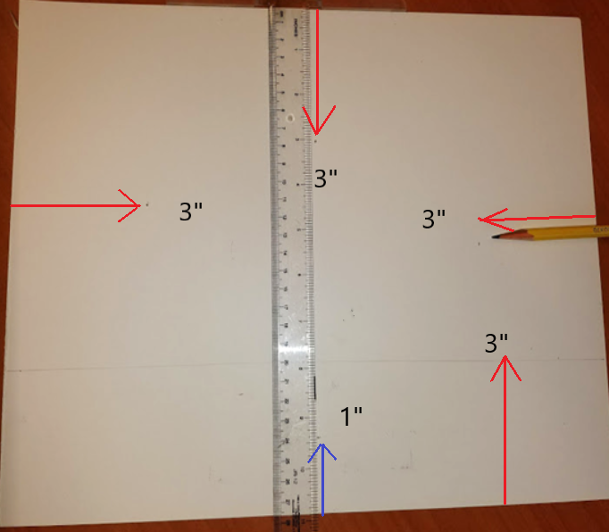
Steps to Make
1. PUT YOUR NAME ON THE BACK OF YOUR PAPER
Start by measuring 3” from all sides. Make a DOT
3” down from top
3” from the left edge
3” from the right edge
3” from bottom (this line will be your grass edge)
Draw the line all the way across the paper LIGHTLY
Measure 1” from the bottom in the middle
(This will be the bottom of the pumpkin)

Slide 10
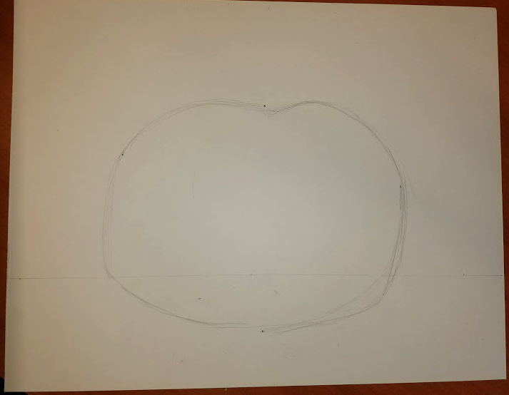
Lightly sketch your pumpkin shape to the 3” mark around your paper.
“Connect the dots with ARCHES”
Create arches between each dot to give the round shape of the pumpkin.

Slide 11
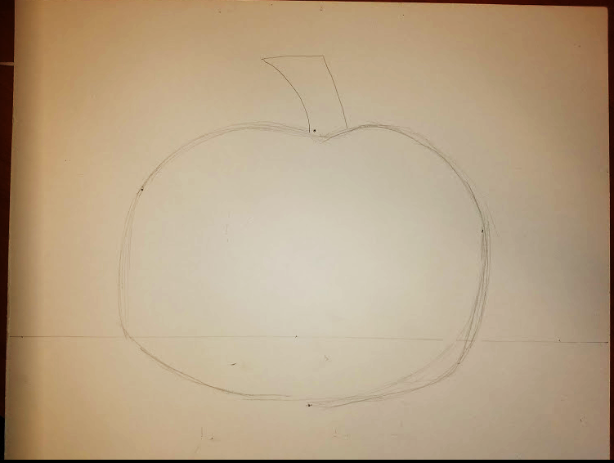
Add your Stem

Slide 12
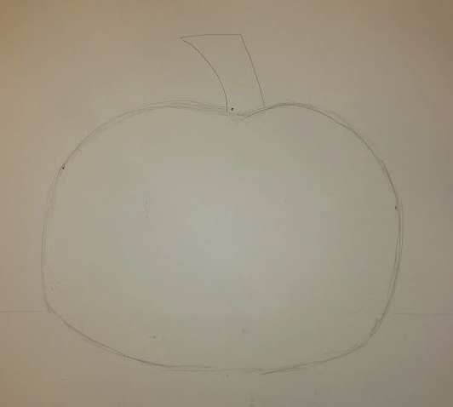
Erase your extra pencil marks

Slide 13
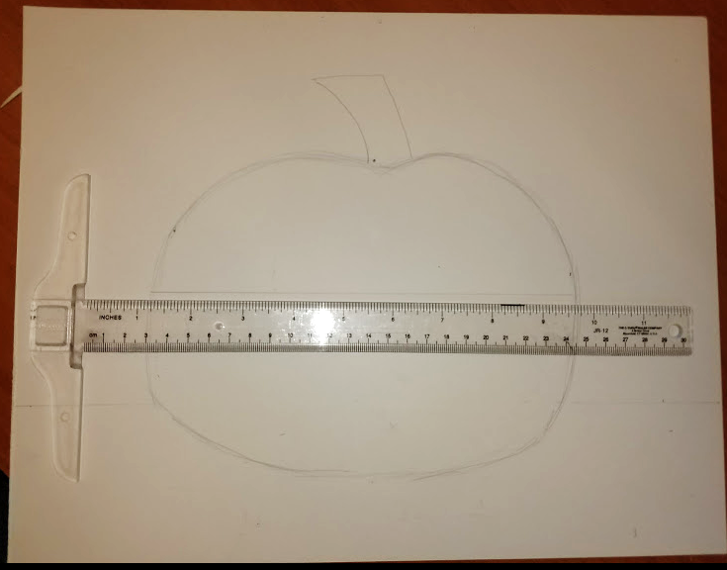
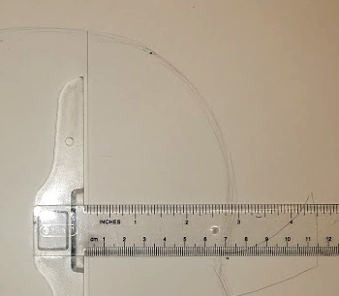
Draw a straight line approximately 3” down from the top of the pumpkin (from ear to ear)
Divide the pumpkin in half:
horizontally
and
vertically

Slide 14
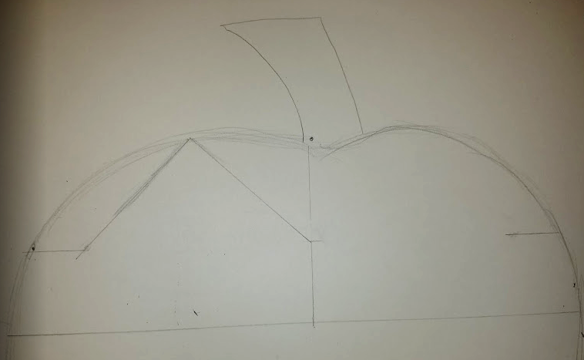
Divide the top portion in half with your ruler (vertically)
Divide the top side in half horizontally
Make a mark that is 3” from center vertical line on the horizontal line.
Left 3”
Right 3”
Draw 2 sides of a triangle from center dot to left dot
3”
3”

Slide 15
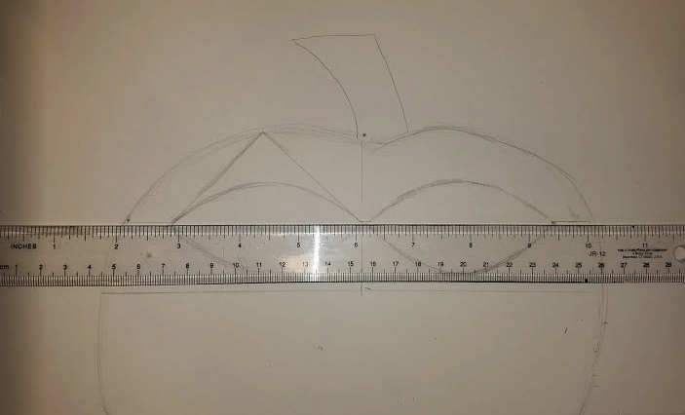
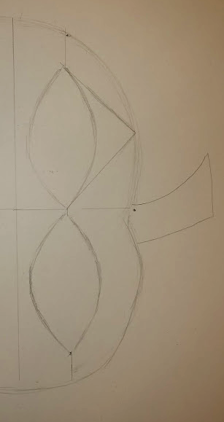
Draw the oval shape of the eye from the 3” mark to the middle vertical line
Repeat the same shape eye on the right side of the face.

Slide 16
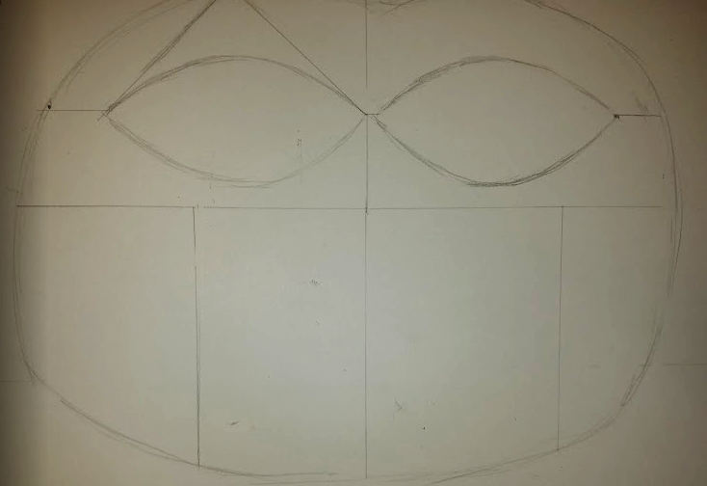
Divide the bottom half of the pumpkin’s face into 4 equal sections vertically

Slide 17
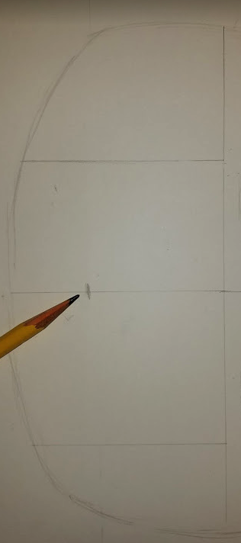
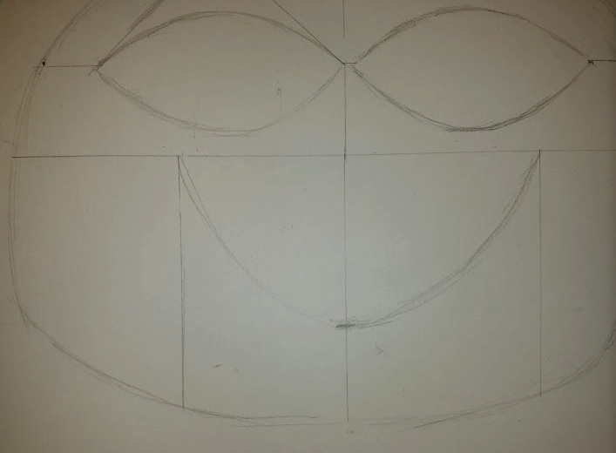
Make a mark to indicate the bottom of the mouth in the middle.
Make the mouth by connecting from the lines on either side down through the middle mark of the mouth

Slide 18
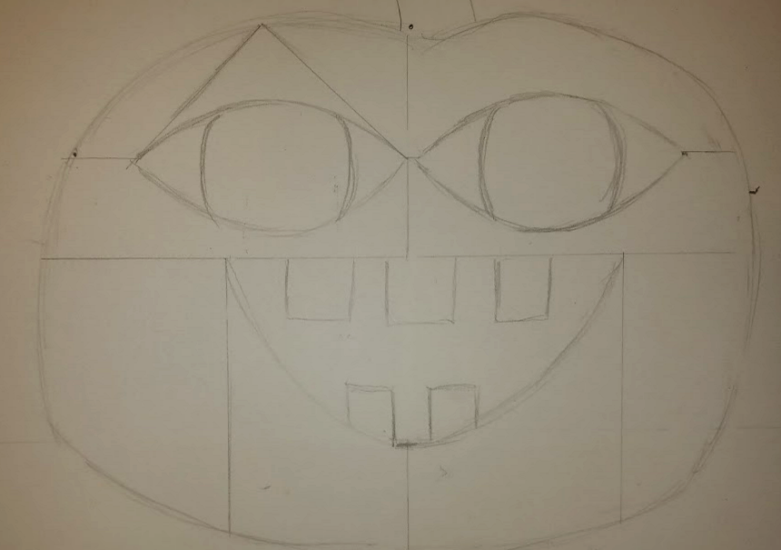
Add your teeth

Slide 19
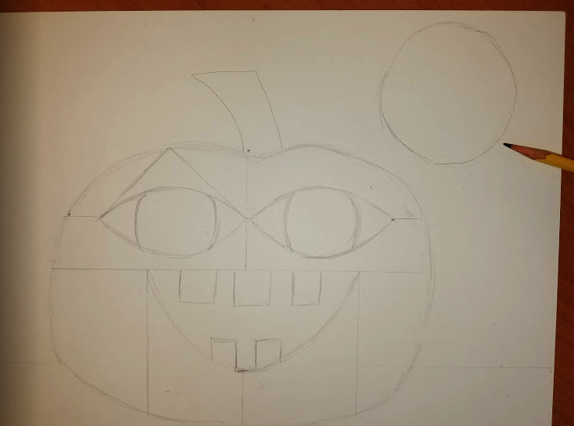
Add a moon

Slide 20
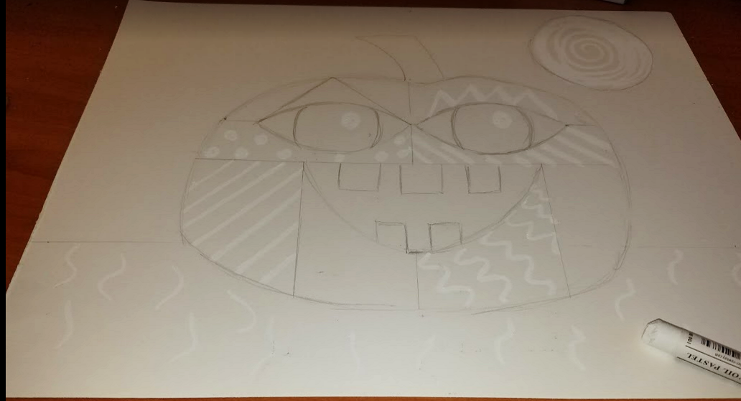
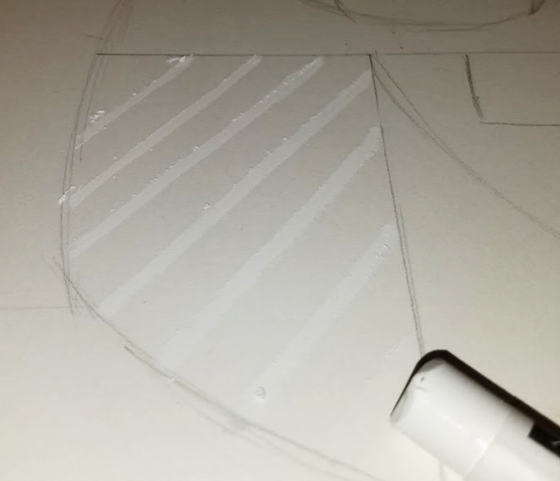
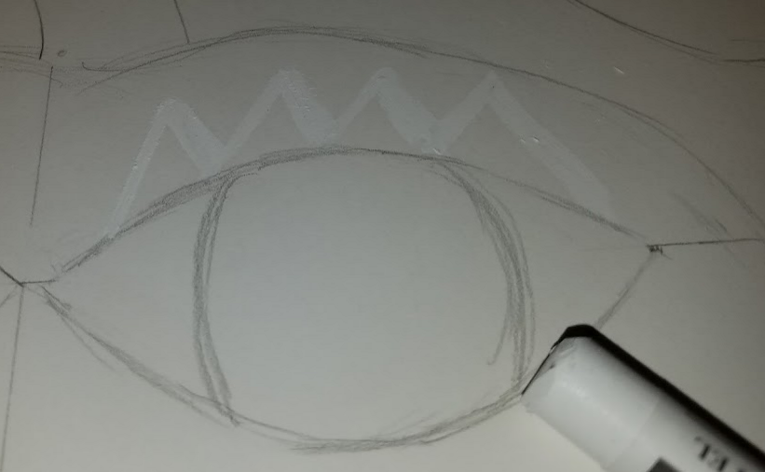
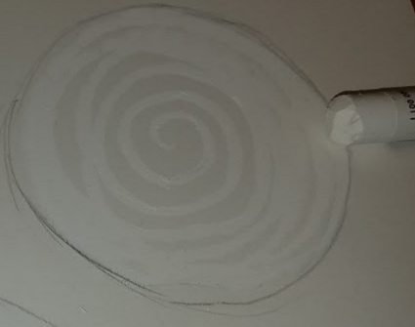
Using the white pastel crayon, make designs on the pumpkin, gass, and moon

Slide 21
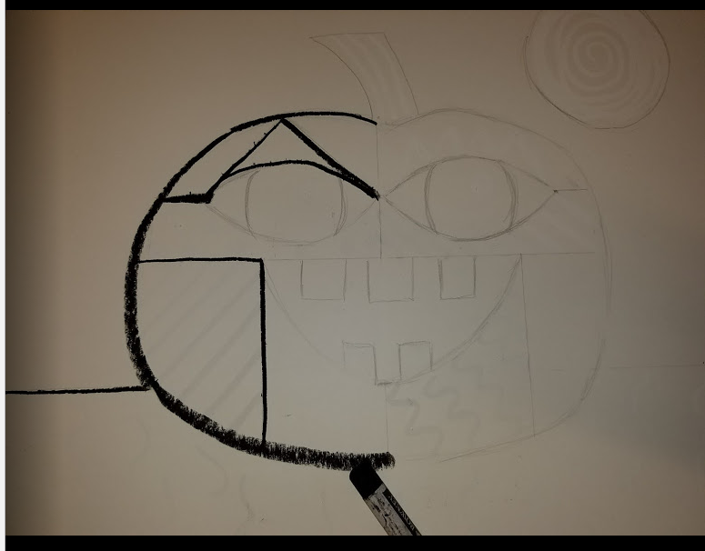
With your black pastel crayon, start on the opposite side of the paper that you hold the crayon.
If you are Right Handed, start on the Left Side of the picture.
Lefties – start on the Right side!
Trace the pencil lines.

Slide 22
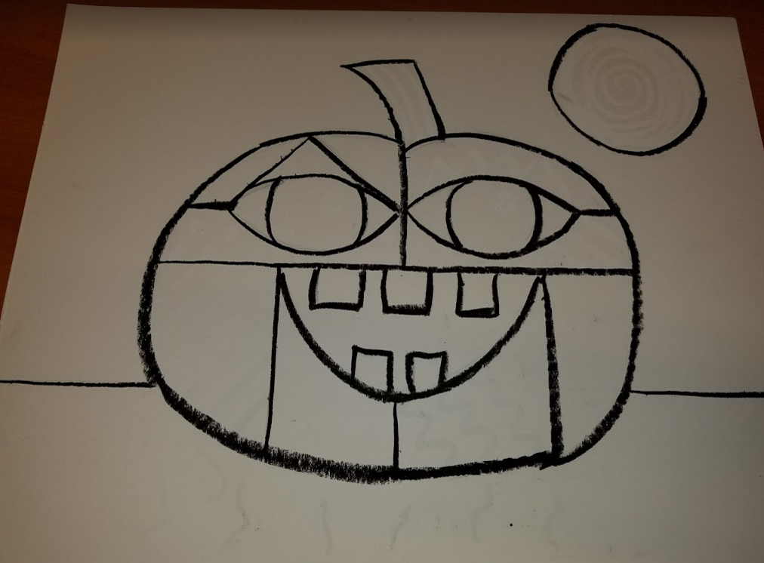
Finish all the black lines

Slide 23
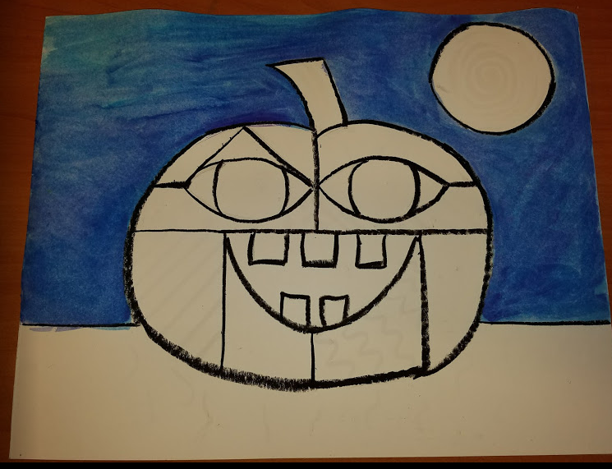
Fill in the sky background
Use long brush strokes
Feel free to mix shades of blue and purple.

Slide 24
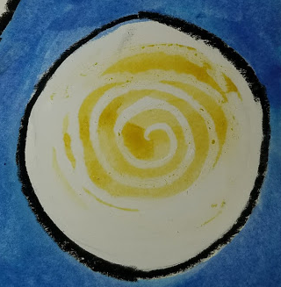
Color the moon yellow

Slide 25
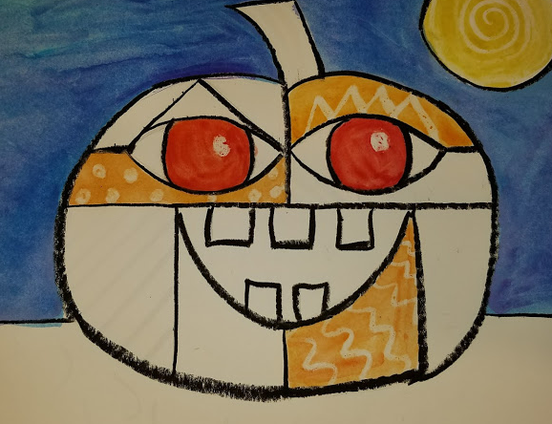
Color the pumpkin in various shades of oranges (light, dark, etc)

Slide 26
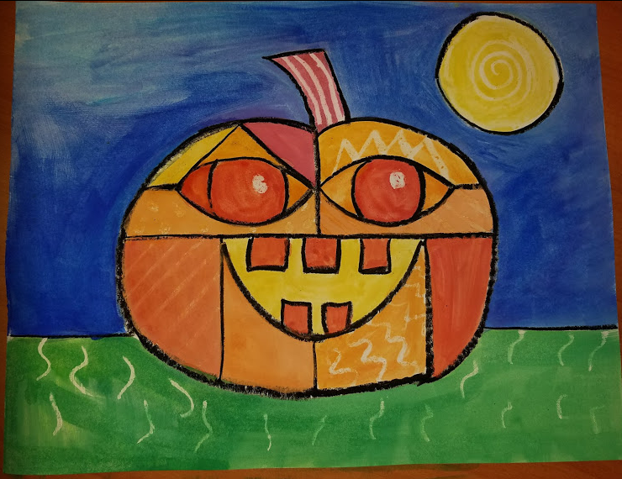
Finish with the green grass

